Slide 1
Human Resource
Management in Islamic Micro Finance Institutions
By: Syed Hussain Haider
Director, Akhuwat Institute of Social Enterprise and Management
CSO, Akhuwat Education Services
Adjunct Faculty, LUMS

Slide 2
RBE --- KBE
Notes:
After studying this chapter, you will be able to:
1. Explain what human resource management is and how it relates to the
management process.
2. Briefly discuss and illustrate each of the important trends influencing human
resource management.

Slide 3
Introduction to HRM
Two questions:
Does it matter?
Why does it matter?
What is HRM?
Organization’s methods and procedures for managing people to enhance skills and motivation
Activities to enhance the organization’s ability to attract, select, retain and motivate people

Slide 4
The Death of HR ?
Traditional “personnel” function
Recordkeeping
Perceived as a dumping ground
The death of HR?
HR’s rebirth
Sources: Caudron (2003); Schuler (1990); Schuler & Walker (1990); Stewart (1996); Sunoo & Laabs (1999); Ulrich (2000); Wells (2003)

Slide 5
HRM and Personnel Management differences
HRM:
places more emphasis on strategic fit and integration,
is based on a management philosophy,
Places more emphasis on mutuality,
is more holistic,
specialists are more like facilitators than administrators,
treats people as assets and not only as an expense.

Slide 6
Definition of HRM
Strategic and coherent approach to the management of an organization’s most valued asset – the people working there who individually and collectively contribute to the achievement of its objectives.

Slide 7
What Is Human Resource Management?
The Management Process
Planning
Organizing
Staffing
Leading
Controlling
Notes:
Understanding the five elements of what managers do (planning, organizing, staffing, leading, and controlling) will assist you in your career. For example, no matter what your job, planning involves establishing goals, rules and procedures and attempting to forecast the future. Planning will enhance your ability to manage people and functions.
For our purposes, we will focus our efforts on basic staffing functions. These include:
Acquiring talented employees
Training new hires and existing managers and employees
Creating and administering effective performance appraisals
Properly compensating employees, and
Attending to concerns about labor relations, health, safety, and fairness

Slide 8
Elements of human resource cycle
Selection: matching available human resources to jobs
Appraisal: performance management
Rewards: focus on organizational performance (most under-utilized and mishandled tool)
short-term and long-term
Development – developing high quality employees

Slide 10
Human Resource Management
1
Staffing
Human Resource Planning
Human Resource Development
Employee and Labor Relations
Compensation
Safety and Health

Slide 11
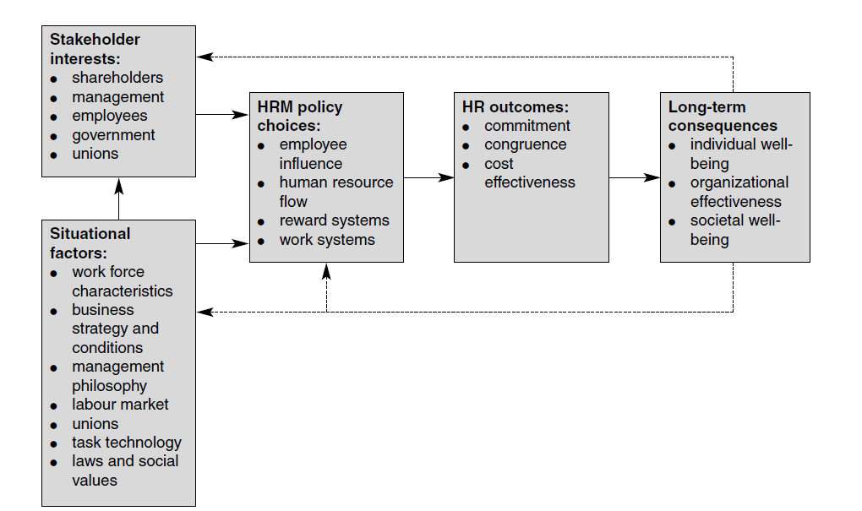
The Harvard Framework

Slide 12
Why Is Human Resource Management Important to All Managers?
No manager wants to:
Hire the wrong person for the job
Experience high turnover
Have your employees not doing their best
Notes:
No manager wants to:
Waste time with useless interviews
Have your company taken to court because of your discriminatory actions
Have your company cited under federal occupational safety laws for unsafe practices
Have some employees think their salaries are unfair relative to others in the organization
Allow a lack of training to undermine your department’s effectiveness
Commit any unfair labor practices
Carefully studying this book will help you avoid mistakes like these.
About one-third of the top HR managers in Fortune 100 companies moved there from other
functional areas. Reasons given include the fact that such people may give the firm’s HR
efforts a more strategic emphasis, and the possibility that they’re sometimes better equipped
to integrate the firm’s human resource efforts with the rest of the business.

Slide 13
Aims of HRM
Organizational effectiveness (HRM makes a significant impact on firm performance)
Human capital management (HC is the prime asset – the aim is to develop the inherent capacities of people)
Knowledge management (support the development of firm-specific knowledge)
Reward management (enhance motivation, job engagement)
Employee relations (harmonious relationship between partners)
Meeting diverse needs (stakeholders, workforce)
Bridging the gap between rhetoric and reality (HRM is to bridge the gap – and to ensure that aspirations are translated to effective action

Slide 14
HRM concepts
People Management
The policies and practice which govern how people are managed and developed in organizations
Human Resources Management
The strategic and coherent approach to the management the most of organization’s most valued assets – the people working there who individually and collectively contribute to the achievements of its objectives
Human Capital Management
An approach to obtaining, analyzing and reporting on data which informs the direction of value adding people management strategic investment and operational decisions at corporate level and at the level of front line management
Personnel Management
Personnel mmanagement is concerned with obtaing, organizing and motivating human resources required by enterprise

Slide 15
Human Resource Management
Part of total management process
Focus on staffing processes
Job analyses
Recruiting
Selecting
Orientation
Compensation
Performance
Compliance issues
Research
Training & Development
Counseling and Grievance Management
Notes:
The HR function is primarily concerned with the “staffing” component of the five management processes, namely, planning, organizing, staffing, leading, and controlling. The key elements of staffing include:
Job analysis
Planning labor needs
Recruiting
Orienting and training new employees
Compensation
Incentives and benefits
Performance appraisal
Communicating
Training and development, and
Employee commitment
In addition, HR is responsible for compliance with federal, state and local laws, safety, and handling grievances and labor relations.

Slide 16
Trends in Human Resource Management
Technological advances
Globalization and competition
Indebtedness (“Leverage”) deregulation
Trends in the nature of work
Demographic and workforce trends
Economic challenges and trends
Notes:
Trends in Human Resource Management
Technology dramatically changed how human resource managers do their jobs.
LinkedIn and Facebook recruiting are examples. Employers can access candidates via Facebook’s
job board. This provides a seamless way to recruit and promote job listings from Facebook. Then,
after creating a job listing, the employer can advertise its job link using Facebook.
Globalization refers to companies extending their sales, ownership, and/or manufacturing to new markets abroad. For example, Toyota builds Camrys in Kentucky, while Dell assembles PCs in China. Free-trade areas—agreements that reduce tariffs and barriers among trading partners—further encourage international trade. NAFTA (the North American Free Trade Agreement) and the EU (European Union) are examples.
Indebtedness In many countries, governments stripped away regulations. In the United States and Europe, for instance, the rules that prevented commercial banks from expanding into stock brokering were relaxed. Giant, multinational “financial supermarkets” such as Citibank quickly emerged. As economies boomed, more businesses and consumers went deeply into debt. Homebuyers bought homes, often with little money down. Banks freely lent money to developers to build more homes creating this bubble in the economy.
Nature of Work In older plants, machinists would manually control machines that cut chunks of metal into things like engine parts.
High-Tech Jobs Today, a team spends much of their time keying commands into computerized machines that create precision parts for products, including water pumps. As the U.S. government’s Occupational Outlook Quarterly put it, “knowledge-intensive high-tech manufacturing in such industries as aerospace, computers, telecommunications, home electronics, pharmaceuticals, and medical instruments” is replacing factory jobs in steel, auto, rubber, and textiles.
Services Today, over two-thirds of the U.S. workforce is already employed in producing and delivering services,
not products. By 2020, service-providing industries are expected to account for 131 million out of 150 million (87%) of wage and salary jobs overall. So in the next few years, almost all the new jobs added in the United States will be in services, not in goods-producing industries.
Manufacturers have been squeezing slack and inefficiencies out of production, enabling companies to produce more products with fewer employees. So, in America and much of Europe, manufacturing jobs are down, service jobs up, and the manufacturing jobs that remain are increasingly high-tech.
Knowledge Work and Human Capital In general, therefore, jobs require more education and more skills. For example, we saw that automation and just-in-time manufacturing mean that even manufacturing jobs require more reading, math, and communication skills.
Demographic and Workforce Trends In spite of recession and job losses, trends in workforce demographic are making hiring good employees more of a challenge around the world. India has not been immune to the effects. Acute skill shortage has been identified as the main hurdle to achieve the demographic dividend from its young, growing population. The current government has made skill development as a top priority in its agenda of economic growth.
“Generation Y” Furthermore, many younger workers may have different work values than did their parents. These “Generation Y” employees (also called “Millennials”) were born from roughly 1977 to 2002. They take the place of the labor force’s previous new entrants, Generation X, those born roughly from 1965 to 1976 (themselves the children of the baby boomers, born roughly from 1946 to 1964). Based on one study, older employees are more likely to be workcentric (to focus more on work than on family with respect to career decisions). Gen Y workers tend to be more family-centric or dual-centric (balancing family and work life).
Retirees Many employers call “the aging workforce” their biggest demographic threat. The problem is that there aren’t enough younger workers to replace the projected number of baby boom–era older workers retiring.
Nontraditional Workers At the same time, work is shifting to nontraditional workers. Nontraditional workers are those who hold multiple jobs, or who are “temporary” or part-time workers, or those working in alternative arrangements (such as a mother–daughter team sharing one clerical job). Others serve as “independent contractors” on projects. Almost 10% of American workers—13 million people—fit this nontraditional workforce category.
Workers from Abroad With projected workforce shortfalls, many employers are hiring foreign workers for U.S. jobs. The H-1B visa program lets U.S. employers recruit skilled foreign professionals to work in the United States when they can’t find qualified American workers. U.S. employers bring in about 181,000 foreign workers per year under these programs.

Slide 17
Trends in Human Resource Management
More knowledge work
Aging workforce
Economic downturn
De-leveraging
Deregulation slowdown
Slower economic growth
Notes:
In addition, there are other trends such as:
More knowledge work
Aging workforce
Economic downturn
De-leveraging
Deregulation slowdown
Slower economic growth

Slide 18
The New Human Resource Manager
Notes:
Today, employers face new challenges, such as squeezing more profits from operations. They expect their human resource managers to have what it takes to address these new challenges.

Slide 19
The New Human Resource Manager
Focus More on Strategy
Focus on Improving Performance
Measure HR Performance and Results
Use Evidence-Based Human Resource Management
They Add Value
They Use New Ways to Provide HR Services
Notes:
Tasks like formulating strategic plans and making data-based decisions require new human resource manager skills. HR managers can’t just be good at traditional personnel tasks like hiring and training. Instead, they must “speak the CFO’s language” by defending human resource plans in measurable terms (such as return on investment).
To create strategic plans, the human resource manager must understand strategic planning, marketing, production, and finance. (Perhaps this is why about one third of top HR managers in Fortune 100 companies moved there from other functional areas.) He or she must be able to formulate and implement large-scale organizational changes, design organizational structures and work processes, and understand how to compete in and succeed in the marketplace.
The bottom line is that today’s employers want their HR managers to add value by boosting profits and performance. “Adding value” means helping the firm and its employees improve in a measurable way as a result of the human resource manager’s actions.
HR will use new technology to free up time for their new strategic duties and to provide HR services cost effectively.

Slide 20
The New Human Resource Manager
They Take a Talent Management Approach
They Manage Employee Engagement
They Manage Ethics
They Understand Their Human Resource Philosophy
They Have New Competencies
Notes:
Improved performance requires engaged employees. The Institute for Corporate Productivity defines engaged employees “as those who are mentally and emotionally invested in their work and in contributing to an employer’s success.” Unfortunately, studies suggest that less than one-third of the U.S. workforce is engaged. Today’s human resource managers need skills to manage employee engagement. We’ll look at employee engagement in later chapters.

Slide 21
Evidence-based Human Resource Management
Notes:
Evidence-based human resource management involves the use of the best available evidence with respect to human resource practices. For example, tracking median HR expense as a percentage of a company’s total operating costs may average less than 1%. The use of this and similar metrics will help control expenses and contribute to profits.

Slide 22
The New Human Resource Managers
Transactional Services
Talent Management
Big picture
Employee Engagement
Performance, results, evidence-based practice
Competencies
Ethics
Notes:
Employers expect their human resource managers to help lead their companies’ performance-improvement efforts. Human resource managers recognize this. Surveys of HR professionals list competition for market share, price competition/price control, governmental regulations, need
for sales growth, and need to increase productivity as top challenges HR managers face.

Slide 23
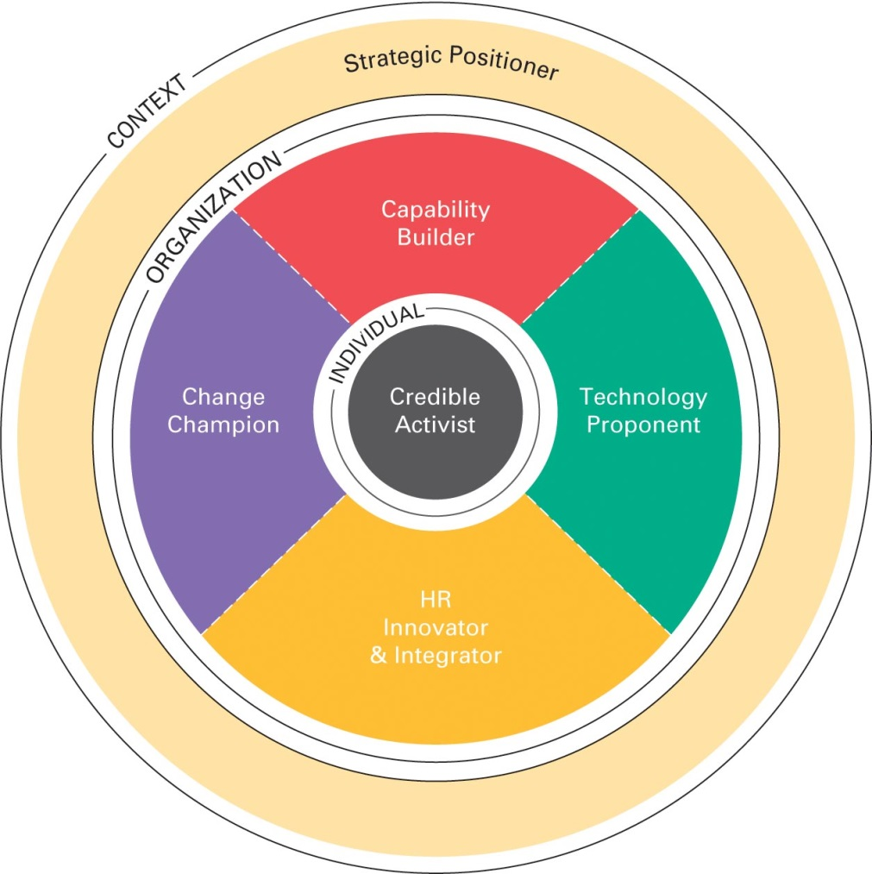
Human Resource Manager’s Competencies
Strategic positioners
Credible activists
Capability builders
HR innovators and integrators
Technology proponents
Notes:
This slide has Figure 1-7 the Human Resource Manager’s competencies.
Strategic positioners—for instance, by helping to create the firm’s strategy.
Credible activists—for instance, by exhibiting the leadership and other competencies that
make them “both credible (respected, admired, listened to) and active (offers a point of view,
takes a position, challenges assumptions).”
Capability builders—for instance, by creating a meaningful work environment and aligning
strategy, culture, practices, and behavior. Capability builders—for instance, by initiating and
sustaining change.
HR innovators and integrators—for instance, by developing talent, and optimizing human
capital through workforce planning and analytics.
Technology proponents—for instance, by connecting people through technology.

Slide 24
Q & A?
Notes:
Copyright

